Slide 1

ANALYZING VIDEO GAME SALES UP TO 2016
By Ahmad Belva

Slide 2
OUTLINE
Data Overview and Objective
Exploratory Data Analysis (EDA)
Machine Learning Model and Evaluation
Conclusion

Slide 3
DATA OVERVIEW

Slide 4


Data Overview
The dataset is obtained from Kaggle: https://www.kaggle.com/datasets/rush4ratio/video-game-sales-with-ratings
Based on the information on the Kaggle page, the data is obtained from VGChartz and Metacritic
VGChartz
Metacritic

Slide 5
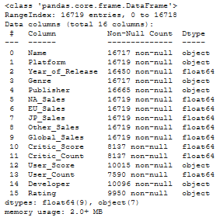
Data Overview (Part 2)
The dataset is comprised of 15 rows
There are 16,719 entry in the dataset
Several features on the dataset were filled with Missing Values
Hence, the analysis will be done after Pre-Processing the dataset
The objective for this analysis are:
To observe how different features affect Global Sales of a game
Create a Machine Learning model to predict Global Sales

Slide 6
EXPLORATORY DATA ANALYSIS (EDA)

Slide 7
Business Question
From the objective mentioned before we can make some Business Questions:
How are different features correlates to a game’s Global Sales?
How well can the Machine Learning model predict a game’s Global Sales? (Given the information in the dataset)

Slide 8
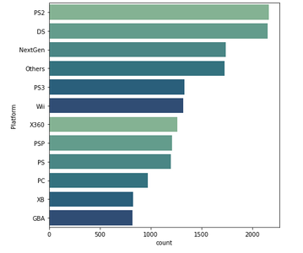
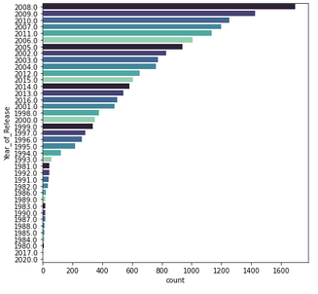
THE NUMBER OF GAMES PRODUCED ARE DOMINATED BY PS2 ERA (6TH GEN), WITH GAME PRODUCTION REACHING THE PEAK ON PS3 ERA (7TH GEN)
Number of game produced up-to 2016 breakdown by Platform
Number of game produced up-to 2016
breakdown by Year

Slide 9
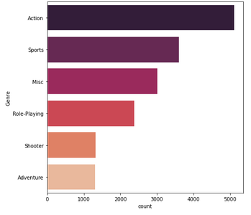
GENRE BREAKDOWN ON ALL GAME PRODUCED SHOWED THAT ACTION IS THE MOST POPULAR GENRE FOLLOWED BY SPORT
After considering genre overlap due to most game having multiple genres, the figure is obtained.
Misc is the combination of all smaller genre which has low game produced, hence being grouped into this category.
Some category is lower due to genre overlap, in which the main genre is always prioritized.

Slide 10
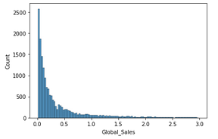
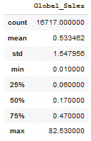
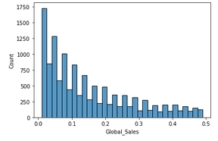
DESPITE HAVING VERY HIGH MAXIMUM SALES, MOST GAME SALES ARE CONCENTRATED AT BELOW 500,000 UNITS WITH THE MOST BEING IN THE NEIGHBORHOOD OF 100,000 UNITS
The feature are Positively Skewed based on the graph and the fact that Mean > Median significantly
The feature has very high variability because the data are measured in Millions. This is more apparent after comparing the Standard Deviation to other Descriptive Statistics

Slide 11
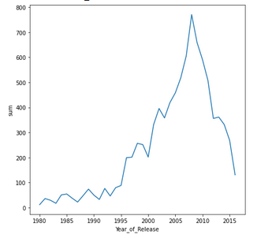
GAME SALES WERE GROWING EVER SINCE THE CREATION OF VIDEO GAMES AND REACH THE PEAK ON 2008, AFTER THAT IT HAS STARTED TO DECLINE SLIGHTLY
Price and number of games during retro era ( year < 2000) are comparably lower than current era.
There are many factors that contributed to the decline in game sales number: increased platform and game price, the rise of mobile gaming.
Recommendation: Try to reduce the game price slightly, offer more discount during holiday, try to make a live service game that is engaging

Slide 12
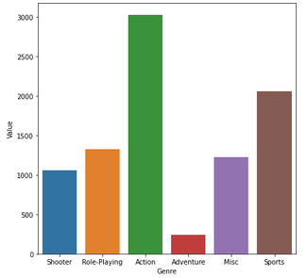
ACTION GAMES GENERATED THE HIGHEST SALES NUMBER FOLLOWED BY SPORTS GAMES OUT OF ALL GENRES FOR GAME SALES UP-TO 2016
This information is mostly in line with the number of game produced on each genre. The exception being RPG exceed Misc in sales number despite having less game produced.
Recommendation: Add some kind of Action elements on the game developed when possible, Try not to focus on 1 genre only (branch out to multiple genre) to make the game more interactive.

Slide 13
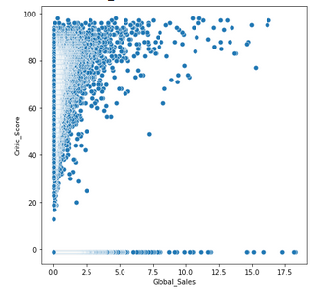
IN HIGH NUMBER OF OBSERVATIONS, HIGHER CRITIC SCORE TRANSLATES TO HIGHER NUMBER OF GAME SALES NUMBER GENERATED
With the exceptions of games with Missing Critic Score, most game sales does correlated positively with Critic Score.
Recommendation: Make better games so it will have better score which will improve the reputation among gamers.

Slide 14
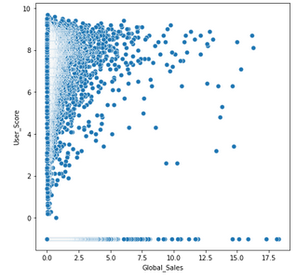
ALTHOUGH NOT AS PROMINENT AS CRITIC SCORE, HIGHER USER SCORE DOES CONTRIBUTES TO THE NUMBER OF GAME SALES NUMBER GENERATED
The result is fairly similar to that of Critic Score although to a lesser extent.
Recommendation is also similar as the better score user gives, the more popular a game gets. So in short try to make better games and understand your audience clearly.

Slide 15
MACHINE LEARNING MODEL AND EVALUATION

Slide 16
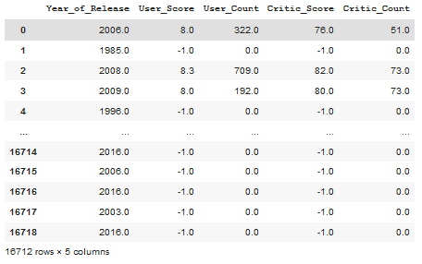
THE RESULT OF DECISION TREE BASELINE MODEL IS FAIRLY OKAY DESPITE NOT BEING VERY AMAZING CONSIDERING THE VARIABILITY IN GLOBAL SALES DATA
Decision Tree was used for Baseline Model.
Features used in the model are only those that has numerical values, as seen in the picture.
The MAE result is 0.506. This means that the model prediction deviates from true Global Sales by 0.506.
The RMSE result is 1.322, Which means the Standard Deviation of prediction error is 1.322.
The independent variable managed to explains 0.137 of variance in the dataset based on R2 score.

Slide 17
RANDOM FOREST MODEL IMPROVED UPON THE BASELINE MODEL BASED ON THE EVALUATION METRICS USED TO MEASURE THE MODEL PERFORMANCE
Features used in the model are: One Hot Encoded Genre and Platform, Year of Release, Critic Score, Critic Count, User Score, and User Count
Target Variable is Global Sales
User Score is found to be highly correlated to Critic Score (absolute correlation > 0.8), so it is dropped.
Cross validation is used to optimize: Max Depth and Number of Estimators
The resulting MAE is 0.455
The resulting RMSE is 1.25
The independent variable managed to explains 0.229 of variance in the dataset based on R2 score.

Slide 18
GRADIENT BOOSTED TREE RESULT, WHILE A LITTLE DIFFERENT FROM RANDOM FOREST, STILL IMPROVED UPON THE BASELINE MODEL
Features used in the model are the same as those in Random Forest Model
Target Variable is Global Sales
User Score is found to be highly correlated to Critic Score (absolute correlation > 0.8), so it is dropped.
Cross validation is used to optimize: Learning Rate, Max Depth, and Number of Estimators
The resulting MAE is 0.439
The resulting RMSE is 1.298
The independent variable managed to explains 0.167 of variance in the dataset based on R2 score.

Slide 19
CONCLUSION

Slide 20
MODEL EVALUATION
The MAE results shows that Gradient Boosted Tree minimize MAE the best, followed by Random Forest. Both improved upon Decision Tree which was used as Baseline Model.
On the other hand, RMSE results shows that Random Forest minimized it the best followed by Gradient Boosted Tree. Both also improved upon the Decision Tree model.
The result is fairly modest because of the high variability in Global Sales (approx. 1.5 Millions) due to many factors like outliers. Furthermore, there are not enough marketing data that more closely correlates to Global Sales.

Slide 21
POINT SUMMARY
Critic Score and User Score are positively correlated to Global Sales
Action and Sports are the genre that contributes to sales the best
Game production peaked during PS2 to PS3 era in around 2008
Most game sales are actually lower than 200,000
Recommendation Recap:
Give more discount during holidays
Try to make engaging live service game
Make better game / know the audience better
Branch out to multiple genre (specifically add Action elements where possible)

Slide 22
THANK YOU

